Slide 1
Geology Mid Topic Test - Review
Year 8 Science

Slide 2
Multiple Choice – highlight the correct answers

Slide 3
1. Explain how the three different types of sedimentary rocks are formed
Clastic: Weathered and eroded materials are deposited in layers and cemented together
Organic: Made from the remains of organisms accumulating and being cemented together
Chemical: When dissolved materials come out of solution, sink and are cemented together.

Slide 4
2. The following are a list of different rocks that have properties as described. Identify them as igneous, sedimentary or metamorphic.
Type of Rock | Description
Sedimentary | shale: strongly layered and fragile, splitting into flat sheets of soft fine particles
Igneous | basalt: very hard rock of small dark crystals
Sedimentary | breccia: large sharp angled particles cemented by many fine rounded particles
Sedimentary | limestone: soft rock with very small rounded white coloured grains including fossil shells found in an ocean reef
Igneous | granite: very hard rock of large crystals of three different colours, white, light grey and black
Metamorphic | gneiss: wavy dark lines set in light coloured rock, the elongated crystals are all lined up parallel to each other

Slide 5
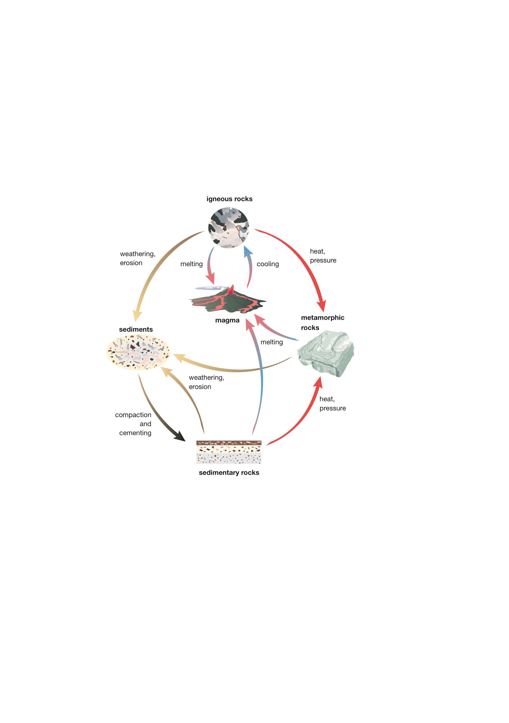

Slide 6
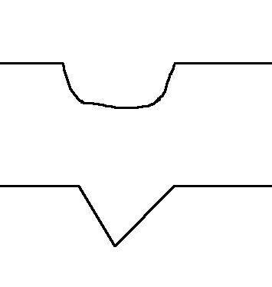
4. The diagram below shows two valleys, one formed by a glacier and the other by a river. Which is which?

Slide 7
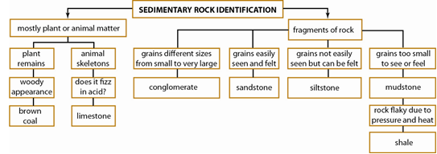
5. Use the sedimentary rock classification key below to answer these questions.

Slide 8
(a) Using the information in the key, describe limestone.
Limestone is described in this key as a rock that consists mostly of animal skeletons and fizzes in acid.
(b) Compare siltstone and conglomerate.
The grains in conglomerate are all different sizes, whereas all the grains in siltstone are so small they are not easily seen.

Slide 9
(c) Grace found a rock with grains in it that were easily visible and of roughly the same size (0.5 mm). Identify this rock.
sandstone

Slide 10
(d) Nick found a rock that he recognised as a mudstone, and it had abundant fossil shells in it. Assess the limitations of (problems with) this key in light of Nick’s discovery.
The key would not correctly identify the rock as it has features of both limestone and mudstone.

Slide 11
(e) Explain why crystal size in igneous rocks is affected by how fast the rock cools.
Slow cooling (over millions of years) produces large crystals because the particles can move around and keep adding to a nearby crystal, which then continues to grow bigger.
Fast cooling (in days or years) does not allow particles enough time to move to large crystals growing nearby and add to these. Instead, they form lots of tiny crystals. Some form no obvious crystals.

Slide 12
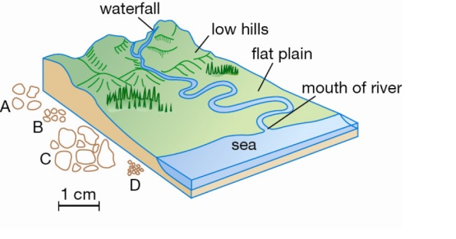
6. Pania and Taye collected sediment from four different places along the course of a river. They made a sketch map of the river with the sampling locations, and they labelled the bottles of sediment. Identify which sediment samples match which location, and explain your four choices.

Slide 13
Sample | Location | Reason
A | from the low hills | . The grains are still large, but are rounded from travelling.
B | Winding part of the river on the flat plain | The grains have been worn small and very rounded from constant rolling in the water.
C | Mountain waterfall | The sediment has large pieces consistent with a high-energy environment, and they have not yet travelled far enough after being smashed to be rounded.
D | Mouth of the river | The water has become quieter and quieter and only fine grains are being transported now.

